Slide 1
Seasonal influenza data in Alberta
(2016-2017)
Seoyeon (Cali) Park
Notes:
Hi everyone,
My name is Cali and today I will be the representative of vaccine company A.
Today I will be presenting the preliminary results of my analysis on seasonal influenza data in Alberta from the 2016-2017 flu season to the minister of health.

Slide 2
Outline
Introduction
Primary Goals
Relevant Background
Data and Model Description
Results and Limitations
Conclusions
Notes:
As you can see on the slides, here is the outline of the presentation for today.
I will begin with a short introduction followed by my primary goals of this analysis.
Then we will move forward to the relevant background and learn about the data and the model.
And end the presentation today with discussing results and conclusions of my analysis.

Slide 3
Introduction
Influenza is a highly contagious respiratory disease, typically occurs in a short time scale (rate of infection approx. 7 days)
COVID-19 pandemic heightened awareness of infectious diseases
Alberta Health branch collects data on confirmed influenza cases from various sources, our focus will be on 2016-2017 season.
Notes:
Influenza, more commonly known as the flu, is a highly respiratory disease that affects up to hundreds of Albertans in every season.
Influenza in Alberta occurs year-round, therefore the Alberta Health branch has data collected on confirmed influenza cases from various sources.
For today’s presentation, we will be focusing on data collected from the 2016-2017 season
However, it is important to note that influenza is often underreported, and the data collected will cover a fraction of the actual influenza cases in Alberta.

Slide 4
PRIMARY GOALS
Parameter Estimation: To understand change in population dynamics
Counterfactual study: Assess preventative measures by analyzing effectiveness of vaccine coverage in Alberta
Notes:
Our goal of this presentation is to go briefly through how the parameters in the models were estimated, and to convey my results from the counter factual analysis that was conducted.
For those of you who do not know, a counterfactual analysis is often used in infectious disease modelling to assess what the situation could have been if there were intervention methods that were placed during the season.
Our focus will be to assess what could’ve happened if there were preventative measures in place such as having efforts in place for a higher vaccination coverage.

Slide 5
Parameter Estimation
Parameters in the model will be estimated using Bayesian Inference
Comparable to traditional parametric methods
Notes:
Beginning our analysis, the parameters in the influenza model were estimated using a Bayesian inference approach.
This is comparable to traditional parametric methods as it allows us to use prior information on parameters from literature to complement to the data.

Slide 6
Counterfactual analysis
Often used to develop a better estimate of what would have happened in the presence of an intervention
In our case, it will be to build an empirical case that an intervention (vaccinations) will produce certain impacts on number of confirmed cases
Notes:
As mentioned previously, counterfactual studies are often used to develop a better estimate of a “what if” situation in the presence of an intervention.
We will use this fact to build a case of what would happen to the number of confirmed cases if there were higher coverage of vaccinations.

Slide 7
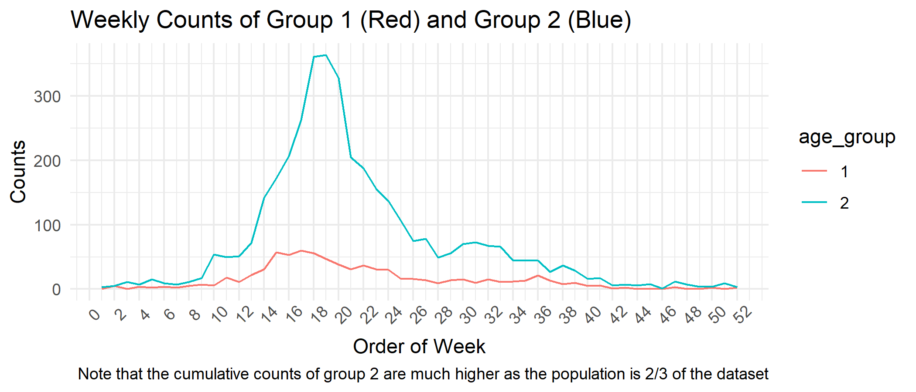
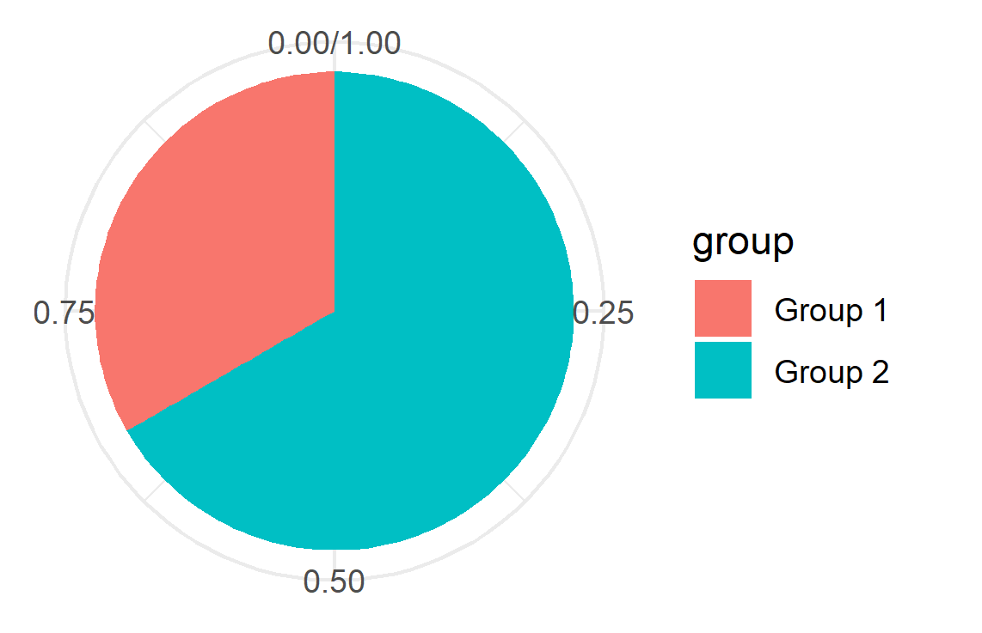
Data
Count Data
Percentage of data in each age group
Provided by Dr. Betsy Varughese – Government of Alberta
Group 1 (< 15 years old): 52/156
Group 2 (15+ years old): 104/156
Notes:
Weekly count data of confirmed cases was used to conduct this analysis
To begin, the data was divided into two groups. Individuals who were less than 15 years old were placed in group 1 and others were placed in group 2.
Group 1 covered 1/3 of the data, and group 2 covered 2/3 of the data.
%Don’t need to say this unless asked
As we can see from the time series graph on the left, it looks like group 2 has far more counts of confirmed cases, but it is important to note the disproportion of numbers within each group, as we can see from the pie chart on the right.
This is the reason why it seems like the counts are far higher in group 2 compared to group 1.

Slide 8
Model
C1
S: Susceptible
I: Infected
C: Confirmed
R: Recovered
Age Groups are indexed by numbers 1 and 2
f
S1
I1
γ
R1
Aging
Aging
Aging
βij
S2
I2
γ
R2
f
C2
Notes:
As you may know, most basic model for analyzing population dynamics during a period of infection is the SIR model.
Here, the S stands for Susceptible, I for infected, R for removed or recovered.
For this analysis we expanded the SIR model to capture a more accurate estimate of the population dynamics by adding a confirmed cases compartment, as well as divide the data into two age groups as previously mentioned.
Therefore, we used a Susceptible-Infected-Confirmed-Recovered model.

Slide 9

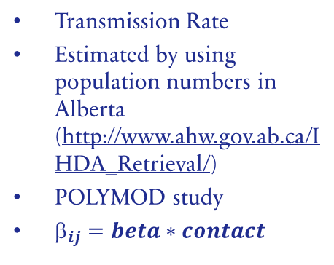
Parameters
$$_{ij}$$
f
γ
Transmission Rate
Estimated by using population numbers in Alberta (http://www.ahw.gov.ab.ca/IHDA_Retrieval/)
POLYMOD study
$_{ij}=beta∗contact$
Case detection rate from infection
Range between 0 and 1
Essentially describes the rate of confirmed cases from our data/population
Recovery rate from infection
Typically calculated by length of time spent in the infectious compartment
γ = 1/infectious period
Assumed to be ≅ 1 based on previous studies on influenza
All parameters were estimated using a Bayesian inference parameter estimation method.
Notes:
The parameters in the model that we estimated are:
the transmission rate beta_ij, the case detection rate f using a bayesian inference method.
The recovery rate was estimated to be around 1 based on previous studies on influenza.

Slide 10
compartment
I01, I02
I01, I02 is the number of infected individuals in age groups 1 and 2
Range between [0 1000], [0 3000]
Assigns a value to our infected population from our data
I01 and I02 were estimated using a Bayesian inference estimation method.
Notes:
In addition to the parameters, number of individuals in each infected compartment were also estimated using the same method.

Slide 11
results
Parameters | b1 | b2 | f | I01 | I02
Prior ranges | [1e-9 1e-6] | [1e-9 1e-6] | [1e-3 1e-2] | [1 1000] | [1 3000]
Median | 4.7260e-8 | 3.6008e-8 | 0.0032 | 519.2979 | 2.6284e+3
95% Credible Interval | (3.6179e-8, 6.0421e-8) | (3.5698e-8, 3.7530e-7) | (0.0028, 0.0036) | (53.8114, 997.2966) | (2.0779e+3, 3.0000e+)
Notes:
The following table shows the estimated median values of parameters as well as its corresponding 95% Bayesian Credible interval.
Analysis was then continued by using these estimated parameters to fit to the data.

Slide 12
Model
C1
f
V
S1
I1
γ
R1
Number of individuals in vaccine compartment will be calculated based on effectiveness and coverage of population
Aging
Aging
Aging
βij
S2
I2
γ
R2
S: Susceptible
I: Infected
C: Confirmed
R: Recovered
V: Vaccinated
Age Groups are indexed by numbers 1 and 2
f
C2
Notes:
For our counter factual study, the previous model SICR was adapted to add a vaccination compartment to group 1.
In other words, we adapted to a Vaccination-Susceptible-Infected-Confirmed-Recovered model.
From statistics published by Alberta Health, it was estimated that influenza immunization was around 27% in Alberta.
Therefore, for our counterfactual study, we will discuss what would’ve happened if there were more coverage and what would’ve happened if the vaccine effectiveness was higher.

Slide 13
results
50% Vaccine Effectiveness
Notes:
We initially considered the situation where the vaccine effectiveness was 50%.
Noting that the vaccination compartment was only added to individuals with age < 15, we see that at each level of coverage, 20%, 30%, 50%, we see that there is a decrease in overall confirmed cases in general.
When we zoom into the peak, we also see that there is a notable decrease in cases, especially between the exact fit and the highest coverage in group 1.

Slide 14
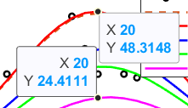
results
75% Vaccine Effectiveness
Notes:
We then considered the situation where the vaccine effectiveness was improved by 25%.
As expected, there is a general decrease in overall confirmed cases.
With higher effectiveness and coverage, we see that there is a significant decrease in cases.
At the peak, we see that the exact fit of cases is above 45 at week 20, whereas with 75% vaccine effectiveness and 50% coverage, the confirmed case compartment of group 1 decreases to about 25. This is a 50% decrease in confirmed cases at week 20.
This concludes the counter factual analysis.

Slide 15
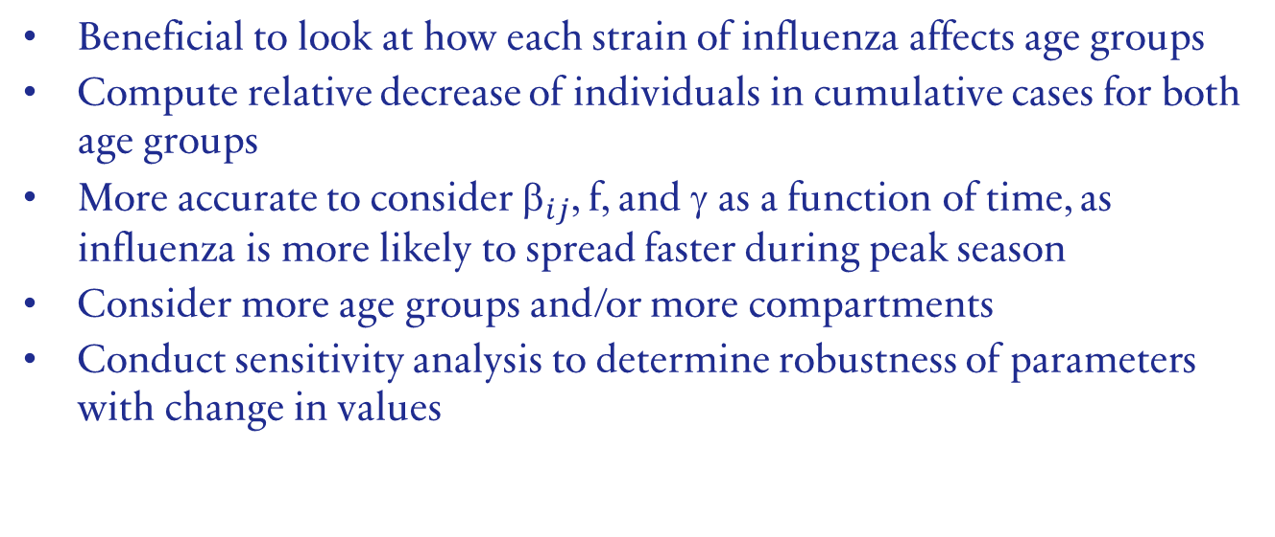
Areas for development/Further works
Beneficial to look at how each strain of influenza affects age groups
Compute relative decrease of individuals in cumulative cases for both age groups
More accurate to consider ${\text{}}_{ij}$, f, and γ as a function of time, as influenza is more likely to spread faster during peak season
Consider more age groups and/or more compartments
Conduct sensitivity analysis to determine robustness of parameters with change in values
Notes:
Even though the results look promising, there is always more areas for development.
Here are some of the areas that could be improved.
To begin, it may be beneficial to consider how different strains of influenza affects different age groups, and to consider adding more age groups and/or more compartments to the model.
In addition, by considering the transmission, case detection rate and the recovery rate as a function of time, we can achieve a more accurate scenario of the spread of influenza, as it is more likely to spread faster and wider during peak season.
Other areas include conducting a sensitivity analysis to determine robustness of parameter.

Slide 16
SUMMARY
Bayesian-based fitting allowed us to estimate the parameters that describe the dynamics of 2016-2017 influenza season in Alberta
Counter-factual analysis of adding an additional vaccination component allowed us to visualize the decrease in confirmed cases in both age groups
Notes:
To summarize what I’ve presented, we first began by estimating parameters in the SICR model that describe the spread of influenza by using a Bayesian inference approach.
We also discussed a counter factual analysis, where we saw that by adding a vaccination compartment with different levels of effectiveness and coverage, the number of confirmed cases decreased in both age groups.
It is therefore advised that the minister of health inform the department to allocate more efforts in increasing vaccination coverage. In addition, it would be beneficial for the company to receive more funding for vaccine research to improve the effectiveness of our influenza vaccine.

Slide 17
references
POLYMOD study
http://www.ahw.gov.ab.ca/IHDA_Retrieval/
Math 572 Lecture Materials

Slide 18
THANK YOU
Seoyeon (Cali) Park
sp8@ualberta.ca
Notes:
Thank you for listening to my presentation today, and I will open the floor up for questions.

Slide 19
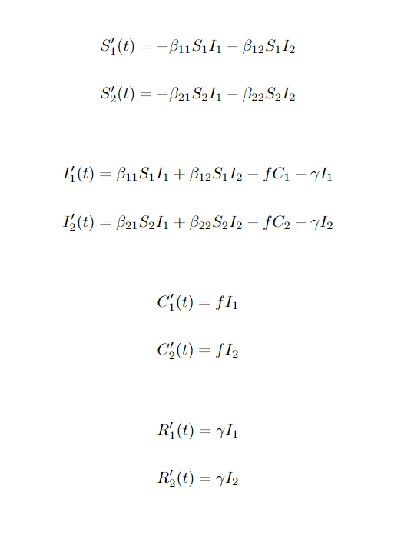
Systems of odes

